Slide 1
The Review of Your NIH Grant Application Begins Here
Richard Nakamura, Ph.D.
Director
NIH Center for Scientific Review

Slide 2
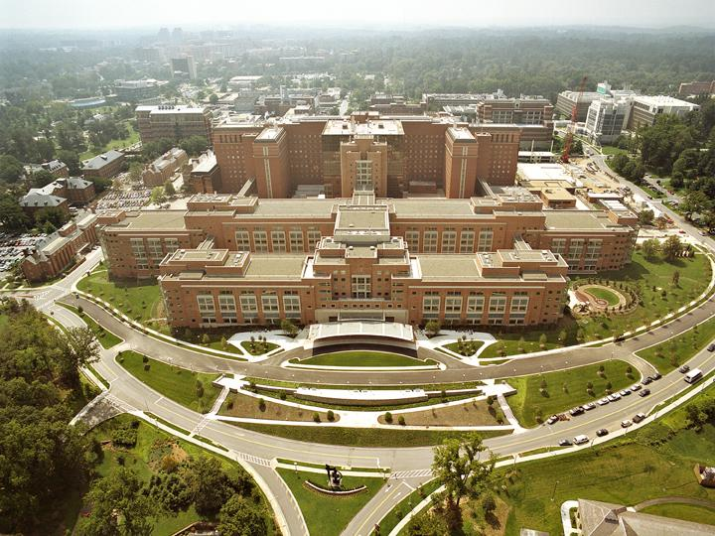
National Institutes of Health

Slide 3
Your Application Could Be Funded by One of 24 NIH Institutes or Centers
Office of the Director
National Institute
on Aging
National Institute
on Alcohol Abuse
and Alcoholism
National Institute
of Allergy and
Infectious Diseases
National Institute
of Arthritis and
Musculoskeletal
and Skin Diseases
National Cancer
Institute
Eunice Kennedy
Shriver National Institute
of Child Health and
Human Development
National Institute on
Deafness and Other
Communication
Disorders
National Institute
of Dental and
Craniofacial
Research
National Institute
of Diabetes and
Digestive and
Kidney Diseases
National Institute
on Drug Abuse
National Institute
of Environmental
Health Sciences
National Eye
Institute
National Institute
of General
Medical Sciences
National Heart,
Lung, and Blood
Institute
National Human
Genome Research
Institute
National Institute
of Mental Health
National Institute
of Neurological
Disorders and
Stroke
National Institute
of Nursing Research
National Institute of
Biomedical Imaging
and Bioengineering
National Center
for Complementary
and Alternative
Medicine
John E. Fogarty
International
Center
National Center
for Advancing
Translational Research
National Library
of Medicine
National Institute on
Minority Health and
Health Disparities
Clinical Center
Center for
Information
Technology
Center for
Scientific Review

Slide 4
NIH Extramural & Intramural Funding
FY 2012 Enacted: $30.9 Billion
Spending
at NIH
$3.4 B Intramural Research
$1.5 B Research Management & Support
$0.3 B Buildings and Facilities, Other
$5.2 B
17%
Supports over 300,000 Scientists & Research Personnel
Supports over 2,500 Institutions
Spending Outside NIH
$25.7 B
83%

Slide 5
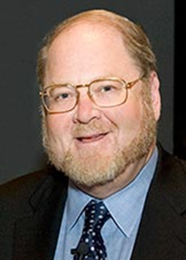
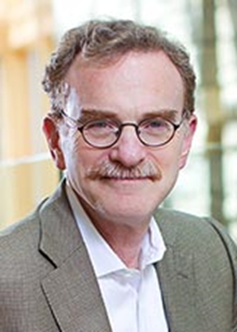
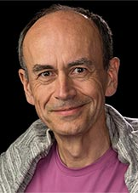
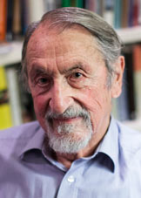
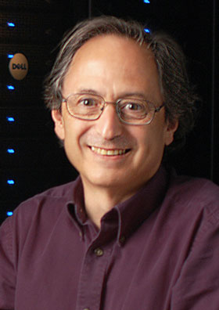
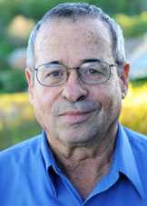
Performance History
NIH-Supported Nobel Prize Winners: 144
2013 Winners
Physiology or Medicine Chemistry
James Randy Thomas Martin Michael Arieh
Rothman Schekman Südhof Karplus Levitt Warshel

Slide 6


The Benefits of Biomedical and Public Health Advances
U.S. Life Expectancy
Source: CDC National Vital Statistics Reports, Vol 60, No 4, January 11, 2012
Notes:
6

Slide 7
Why Has NIH Been So Successful?
Peer Review
Focus is on funding ideas not institutions.
Ideas spring from local researchers.
Researchers must compete – like entrepreneurs – for funding.
Scientific experts do the judging.
Institutions receive funds only when their scientists submit successful applications.
NIH program and review staff are separated.
Scientists manage the peer review process.

Slide 8





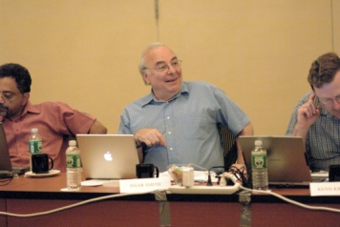
NIH Peer Review System for Grant Applications

Slide 9
Review Process for a Research Grant
National Institutes of Health
Research
Grant Application
School or Other
Research Center
Center for Scientific Review
Assigns to IC & IRG/Study Section
Initiates
Research Idea
Study Section
Submits Application
Reviews for Scientific Merit
Institute
Allocates Funds
Evaluates for Relevance
Advisory Councils and Boards
Conducts
Research
Recommends Action
Institute Director
Takes Final Action

Slide 10

The Gateway for NIH Grant Applications
The Center for Scientific Review
Receives all NIH applications
Refers them to NIH Institutes/Centers and to scientific review groups
Reviews for scientific merit about 70% of all NIH applications

Slide 11
CSR Peer Review – Fiscal Year 2013
84,000 applications received
17,000 reviewers
236 Scientific Review Officers
1,500 review meetings

Slide 12

CSR Mission
To see that NIH grant applications receive fair, independent, expert, and timely reviews – free from inappropriate influences – so NIH can fund the most promising research.

Slide 13
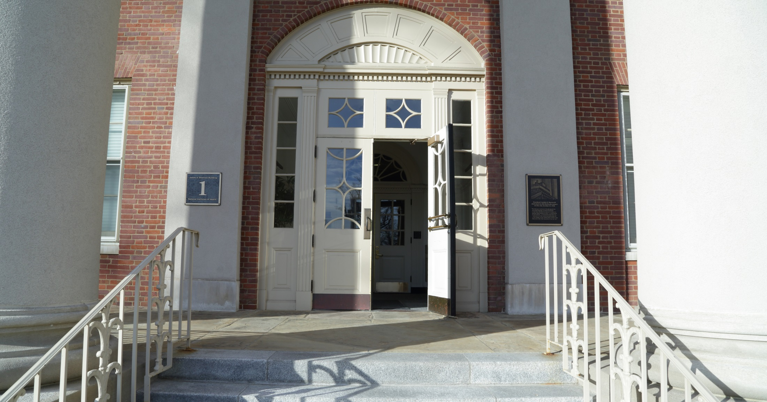
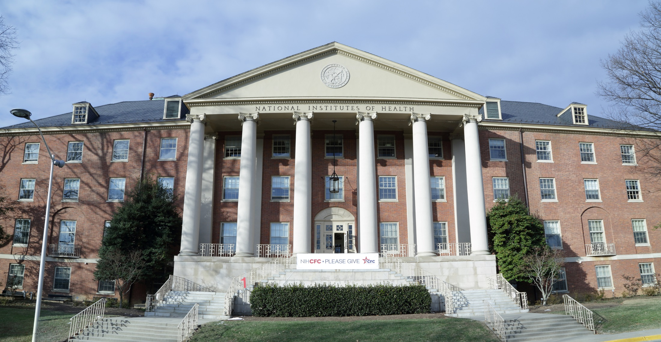
We Want Your Applications!
Notes:
We want you to send us your promising research applications!

