Slide 1
What University Administrators Need to Know About Getting from Submission to Review
Cathleen Cooper, Ph.D.
Director, CSR Division of Receipt and Referral

Slide 2
Electronic Application Process (Overview)

Slide 3
Prepare to Apply and Register

Slide 4
Registrations Required to Submit Applications
Why are so many registrations required?
Verify Eligibility to Apply
Satisfy Legal Requirements
Track and Account for Expenditure of Federal Money
Create Reports
All registrations MUST be completed and active before submission
http://grants.nih.gov/grants/ElectronicReceipt/files/registration_handout.pdf

Slide 5
Registration Reminders, Part I
Several WEEKS before you submit:
Log on to SAM, Grants.gov and eRA Commons
Ensure all registrations will be active ON submission day OR
Update/renew registrations as required.
BEWARE: Systems for Award Management (SAM)
Expires annually, reminders sent to E-biz Point Of Contact (POC)
Can take 6 weeks to establish/renew
Has multiple steps where your input is required to move forward
Takes 24 business hours until SAM activation is recognized on Grants.gov

Slide 6
Registration Reminders, Part II
Keep your E-biz POC up-to-date (SAM)
Have multiple AORs (people authorized to submit applications)
Note that NIH does not accept applications submitted late due to expired or inactive registrations.

Slide 7
Find a Funding Opportunity Announcement

Slide 8
Funding Opportunity Announcements (FOAs)
All applications MUST be submitted to an active FOA
An appropriate NIH Institute/Center must be sponsor/co-Sponsor on that FOA
Application form packets must be downloaded from the FOA you intended to use (if not using system-to-system solution)

Slide 9
Find a Funding Opportunity (FOA)

Slide 10
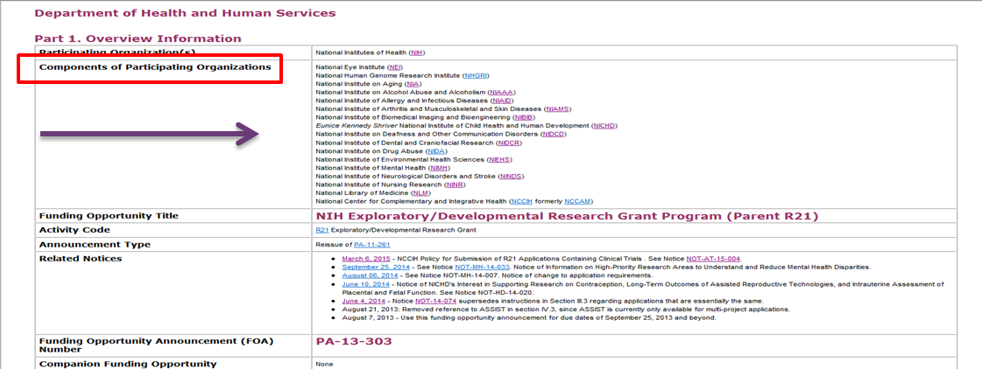
Not all NIH Institutes/Centers are on all FOAs
Only these ICs can fund an application through this FOA

Slide 11
FOA # is Hardwired in Application Forms Packet
Application will be submitted to this FOA
Why is this important?
Re-using old application packet for new FOA sends new application to old FOA
Expired application packet will bounce at Grants.gov

Slide 12
Follow Application Guide and Instructions

Slide 13
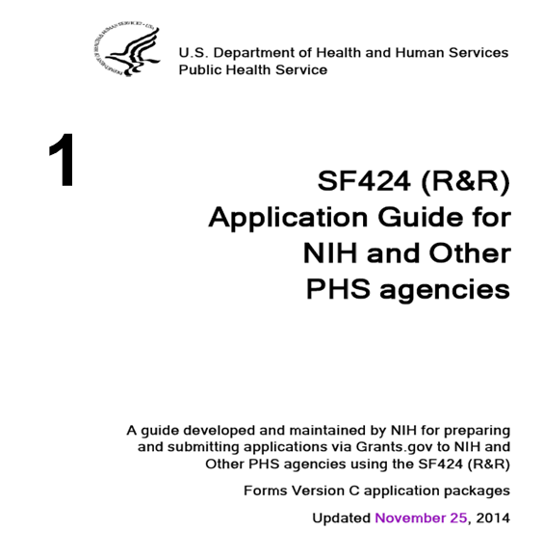
Use These Sources to Prepare Application
The SF424 Application Guide
The FOA
NIH Guide Notices

Slide 14
Get the Latest New and Information about NIH
Subscribe to the NIH Guide Listserv:
http://grants.nih.gov/grants/guide/listserv.htm
Get a weekly digest of
New Guide Notices with information you need to know
New Funding Opportunity Announcements

Slide 15
Submit and Track Your Application

Slide 16
How NOT to submit a Late Application
START EARLY!
Application must be accepted TWICE: Grants.gov and NIH
Grants.gov tracking number looks like this: GRANT12345678
eRA Commons tracking number looks like this: AN3087654
Your application has not been (provisionally) accepted by NIH until it as an accession (AN) number.

Slide 17
Follow your e-Submission!
Check eRA Commons for your submitted application
(e-mails are sent but can be caught in SPAM filters)
High volume at deadlines slows processing/validation time
On time application = submitted error-free by 5 PM local (applicant organization) time on due date
Errors cause rejection – Warnings are error-free and accepted
No error correction window that extends deadline

Slide 18
NIH Late Policy – NOT-OD-15-039
On time application – error free application submitted by 5 PM local (applicant organization) time on the due date.
Under limited circumstances, NIH might accept an application submitted within the two weeks after the due date.
Please read NOT-OD-15-039 carefully for the terms and limitations of the NIH late policy.

Slide 19
Keep Track of Your Application
AORs submit applications
PD/PIs are responsible for accuracy of content
You should not wait for e-mails; proactively check eRA Commons!
Remember
It is your PI’s career and livelihood on the line
Do not make any assumptions!
Notes:
Some important reminders. The Authorized Organizational Representative (AOR) in your grants office is responsible for submitting your application on time, but you are responsible for the content. Do not sit back and wait for e-mails. Proactively check your eRA Commons account. If you cannot see your application in Commons, neither can we, and if we can’t see it we can’t review it. Start the submission process early – days early rather than hours early – so that you have plenty of time to view your application after it is complied on Commons. Sometimes things don’t look the same in Commons as it did on your office computer. Take the time to look at the application the way your reveiwers will see it. Attachments such as letters of support can be omitted. Give yourself plenty of time to submit a corrected copy if necessary. We cannot accept missing pieces or corrected pages after the fact.

Slide 20
NIH has your application! What happens next?

Slide 21
DRR is at the End of the Grants.gov Pipeline
Incoming applications for all of NIH + other HHS Agencies
Remaining applications distributed among CSR IRGs
Problems? Policy Compliance?
Notes:
DRR is at the end of the Grants.gov pipeline. We process applications for organizations across the Department of Health and Human Services in addition to the NIH. Some applications are sent directly to various NIH institutes for review. The remaining applications, about 70%, are distributed among CSR study sections. DRR also plays an active role in problem solving and policy compliance.

Slide 22
What does DRR do?
Determines if application is
on time
formatted correctly
complete
compliant
Considers Cover Letter Requests
Makes Institute Assignment for funding consideration
Makes Study Section Assignment for review

Slide 23
Honoring Assignment Requests
CSR takes assignment requests seriously, and will try to honor them with the requested assignment, but keep in mind:
Application will be sent first to requested IC/IRG, BUT ICs/IRGs can decline the assignment if not appropriate
Some FOAs are already set for IC vs. CSR review
Some FOAs are clustered for review in a SEP
Other issues are considered such as conflict of interest on requested review group

Slide 24
Follow Progress of Application in eRA Commons

