Slide 1
Top 5 Things Institutions Need to Know about the NIH Grants Program
Michelle Bulls
Director, Office of Policy for Extramural Research Administration

Slide 2
Top 5 Questions
#1: How long does it take to get funded?
#2: How do I track my application?
#3: Who is working on my application?
#4: Got Funded! Now What?
#5: Where can I find more information?

Slide 3
#1: How Long Does It Take to Get Funded?

Slide 4
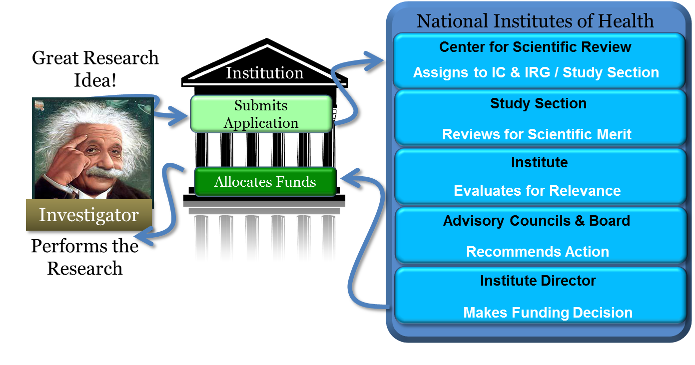
How does a grant get funded?

Slide 5
Ready for Award…When?
All pre-award issues are resolved
Budget Negotiation
Certification on Education on Human Subjects
Animals & Human Subject Protection Issues
Other Support Documentation
Application to award takes ~9-10 months

Slide 6
#2:How do I track my application?

Slide 7
#2:How do I track my application?
In Commons you can find:
Application image
Application status
Assignments (institute, review group)
NIH staff contacts (SRO, program, grants management)
Scores
Summary statement (PI only)
Notice of Award
Links to tools for reporting, no cost extensions, etc.
and more…
Commons.era.nih.gov

Slide 8
#2:How do I track my application?
Work with your institution’s office of sponsored research to be sure you are registered and your account is affiliated with your institution BEFORE you apply.
2 weeks lead time – PI registration in Commons
6-8 weeks – All institutional registrations and renewals
Commons.era.nih.gov

Slide 9
#3: Who is working on my application?

Slide 10
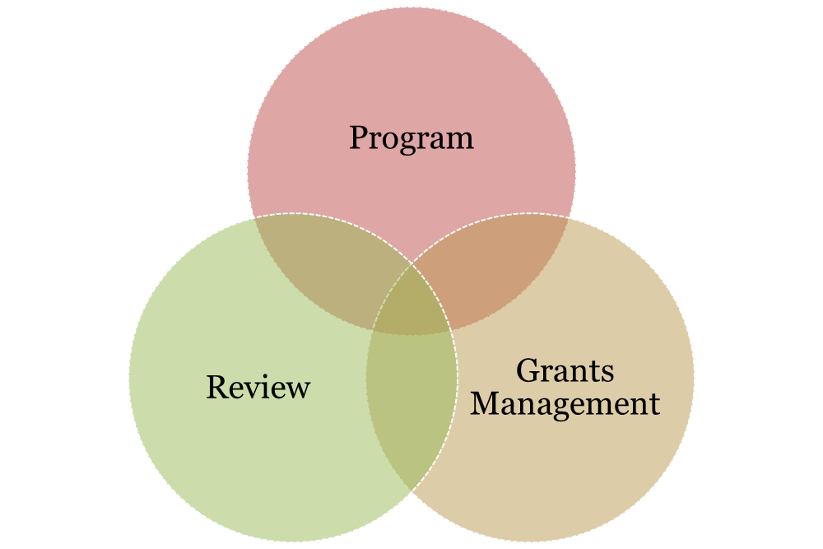
Understand the NIH Extramural Team
Notes:
Review, program and grants management each have a role in the application/award process, so we’ll go into those a little bit now.

Slide 11
Program Official
Responsible for the programmatic, scientific, and/or technical aspects of a grant
Provides scientific guidance to investigators pre- and post-award
Develops initiatives
Provides post-award oversight

Slide 12
Scientific Review Officer
Responsible for scientific and technical review
Reviews applications for completeness and conformance with application requirements
Ensures fair and unbiased evaluation of scientific and technical merit
Provides a summary of the review discussion
Point of contact for applicants during the review process

Slide 13
Grants Management Officer
Responsible for completion of business management requirements
Evaluates applications for administrative content and compliance with policy
Negotiates Awards
Interprets grants administration policies

Slide 14
Finding the Right Staff Contacts
FOAs include contact names for program, review and grants management staff.
Institute websites have org charts or contact lists to help you find a name. www.nih.gov
RePORTER provides the NIH program official’s name for funded projects. projectreporter.nih.gov
Use the NIH Staff Directory if you already have a name ned.nih.gov

Slide 15
Institutional Roles and Responsibilities
What is your role?
What roles do other people play?
Authorized Organizational Representative
Principal Investigator
Administrator
Coordination and respect for each other’s roles is key
Understand your institutional processes and timelines for grant related activities

Slide 16
#4: Got Funded…Now What?

Slide 17
You’ll Receive a Notice of Award (NoA)
Legally binding document
Award data and fiscal information
Grant payment info
Terms and conditions of award
Grantee accepts terms and conditions of award when draws down funds

Slide 18
NIH Grants Policy Statement
Is a term and condition of all grant awards
Explicitly defines roles, responsibilities
grants.nih.gov/grants/policy/nihgps
Notes:
The standard terms and conditions are located in the NIHGPS. The NIHGPS incorporates the applicable grant regulations that apply to NIH awards.
An award that includes a conditional restriction should include the appropriate details as to how to lift that restriction, eg who to submit info to
The award-specific terms are located on the awards document, including a mention of the appropriate use of unobligated funds, and whether or not those funds are available for automatic carryover.
There are informational terms, including appropriate URLs and addresses for submitting information.
And the most helpful information bits are the names and contact information of your grants management specialist and program official. The contact information will include the telephone number and e-mail address

Slide 19
Post Award Management
Annual progress reporting
Annual federal financial reporting
Invention reporting
Yearly audits (as applicable)
Closeout reporting

Slide 20
#5: Where can I find more information?
You will be successful

Slide 21
Bookmark Grant.nih.gov
Bookmark GRANTS.nih.gov

Slide 22
Thank You!

