Slide 1
8 Ways to Successfully Navigate NIH Peer Review and Get an SBIR/STTR Grant
Dr. Gagan Pandya
Scientific Review Officer
October 18, 2017

Slide 2
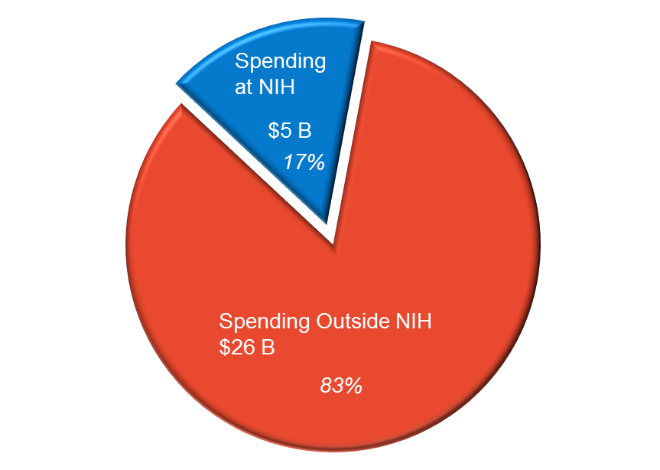
How to Get a Piece of the Pie FY 2016 Enacted: $31.3 Billion

Slide 3
SBIR/STTR Application Types
Goal: Small Business Applications
Stimulate scientific & technological innovation & increase private sector commercialization innovation derived from federal R&D
Phase I application (1R41, 1R43)
Establish feasibility of the project
Comment on commercial potential
Phase II application (2R42, 2R44)
Progress of Phase I objectives
Must provide commercialization plan
Fast-track (Phase I & II) application (1R42, 1R44)
Phase I measurable goals (quantitative milestones) to initiate Phase II
Must provide a commercialization plan
Notes:
Know what is required for your application

Slide 4
8 Ways to Successfully Navigate NIH Peer Review
Know the Path of a Successful Application

Slide 5
8 Ways to Successfully Navigate NIH Peer Review
Know the Path of a Successful Application
Avoid Top Show Stoppers for SBIR/STTR Applicants

Slide 6
8 Ways to Successfully Navigate NIH Peer Review
Know the Path of a Successful Application
Avoid Top Show Stoppers for SBIR/STTR Applicants
Help Direct Your Application to the Best Place for Review and Funding

Slide 7
8 Ways to Successfully Navigate NIH Peer Review
Know the Path of a Successful Application
Avoid Top Show Stoppers for SBIR/STTR Applicants
Help Direct Your Application to the Best Place for Review and Funding
Understand Who Your Reviewers Are

Slide 8
8 Ways to Successfully Navigate NIH Peer Review
Know the Path of a Successful Application
Avoid Top Show Stoppers for SBIR/STTR Applicants
Help Direct Your Application to the Best Place for Review and Funding
Understand Who Your Reviewers Are
Know What Reviewers Are Looking for

Slide 9
8 Ways to Successfully Navigate NIH Peer Review
Know the Path of a Successful Application
Avoid Top Show Stoppers for SBIR/STTR Applicants
Help Direct Your Application to the Best Place for Review and Funding
Understand Who Your Reviewers Are
Know What Reviewers Are Looking for
Consider Advice Collected from NIH Reviewers & Staff

Slide 10
8 Ways to Successfully Navigate NIH Peer Review
Know the Path of a Successful Application
Avoid Top Show Stoppers for SBIR/STTR Applicants
Help Direct Your Application to the Best Place for Review and Funding
Understand Who Your Reviewers Are
Know What Reviewers Are Looking for
Consider Advice Collected from NIH Reviewers & Staff
Benefit from Becoming Review Panel Member

Slide 11
8 Ways to Successfully Navigate NIH Peer Review
Know the Path of a Successful Application
Avoid Top Show Stoppers for SBIR/STTR Applicants
Help Direct Your Application to the Best Place for Review and Funding
Understand Who Your Reviewers Are
Know What Reviewers Are Looking for
Consider Advice Collected from NIH Reviewers & Staff
Benefit from Becoming Review Panel Member
Ask the Right NIH Person for Help

Slide 12
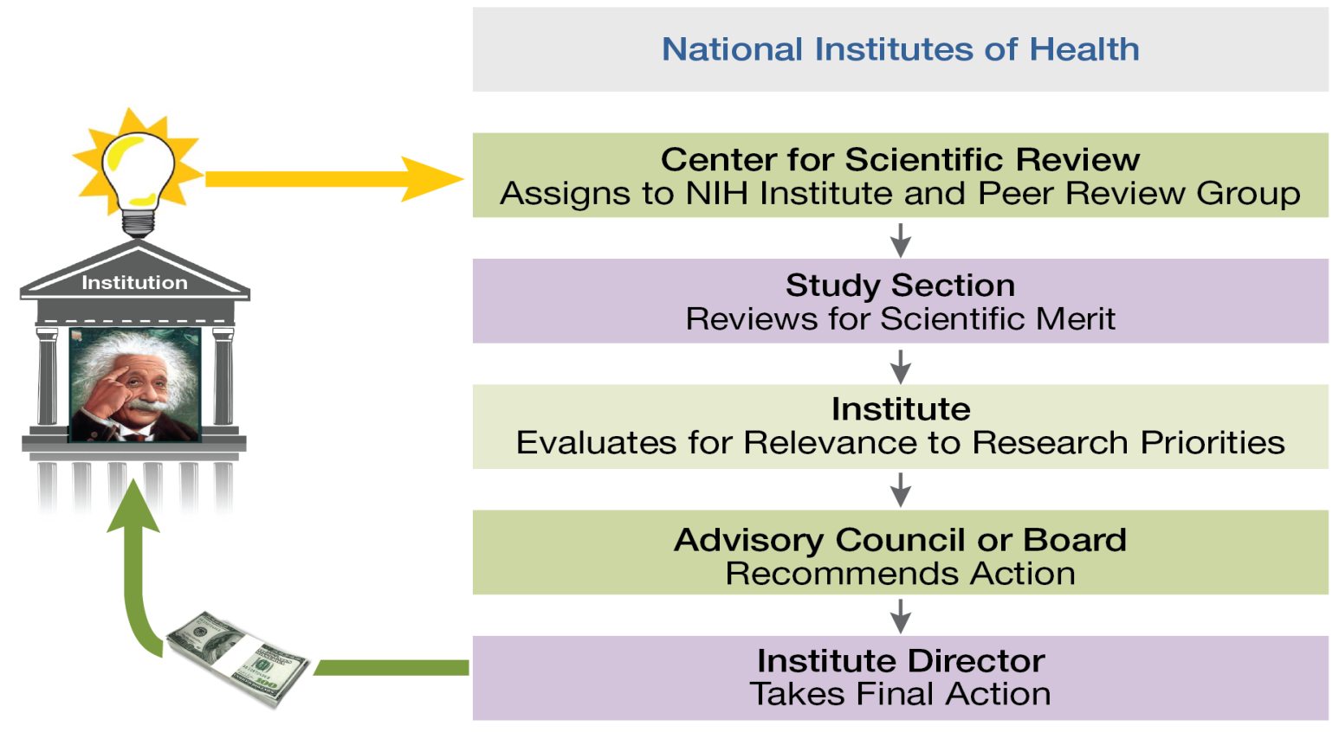
1. Know the Path of a Successful Application
Notes:
In one slide, we’re going to show you How NIH Peer Review Works
NIH has a two-stage review process powered by the input of multiple external experts and other stakeholders. Stage One: Evaluation for Scientific Merit by external scientific experts from academia and industry. Stage Two: Evaluation for Relevance to Research Priorities by the relevant NIH Institute or Center, which consults more senior scientific experts, patients and patient advocates on its Advisory Council.

Slide 13
View the Video – See Real Reviewers in Action
http://www.csr.nih.gov/video/video.asp
Notes:
You’ll see how three reviewers are assigned to your application and how they start the discussion of your application.

Slide 14
2. Avoid Top Show Stoppers for SBIR/STTR Applicants
Not Having Multiple Registrations in Place
Failing to Appreciate Submission Is a Multi-Step Process
Submitting Your Application at the Last Minute
Attempting to Fix a Warning after the Deadline
Not Using the Right Application Form
Not Giving the Instructions Enough Attention
Producing an Incomplete Application
Overstuffing Your Application
Submitting a New Application but Referring to Previous Review Outcomes or Criticism
Using a Small Font
Notes:
Failing to Appreciate Submission Is a Multi-Step Process: your and your institution must have all the required registrations completed and in place at the time of application submission. All applications must be submitted to a Funding Opportunity Announcement (FOA), so you will need to find one of those that fits your application (more on that later). Then you need to download the application package from that FOA, and follow all the instructions in the FOA and the application guide when you are preparing your application. It is your responsibility to view your application and track its progress through the system. NIH and CSR first see your application after it clears Grants.gov.

Slide 15
2. Avoid Top Show Stoppers for SBIR/STTR Applicants
Not Having Multiple Registrations in Place
Failing to Appreciate Submission Is a Multi-Step Process
Submitting Your Application at the Last Minute
Attempting to Fix a Warning after the Deadline
Not Using the Right Application Form
Not Giving the Instructions Enough Attention
Producing an Incomplete Application
Overstuffing Your Application
Submitting a New Application but Referring to Previous Review Outcomes or Criticism
Using a Small Font
Notes:
Failing to Appreciate Submission Is a Multi-Step Process: your and your institution must have all the required registrations completed and in place at the time of application submission. All applications must be submitted to a Funding Opportunity Announcement (FOA), so you will need to find one of those that fits your application (more on that later). Then you need to download the application package from that FOA, and follow all the instructions in the FOA and the application guide when you are preparing your application. Your responsibility to view your application and track its progress through the system. NIH and CSR first see your application after it clears Grants.gov.

Slide 16
2. Avoid Top Show Stoppers for SBIR/STTR Applicants
Not Having Multiple Registrations in Place
Failing to Appreciate Submission Is a Multi-Step Process
Submitting Your Application at the Last Minute
Attempting to Fix a Warning after the Deadline
Not Using the Right Application Form
Not Giving the Instructions Enough Attention
Producing an Incomplete Application
Overstuffing Your Application
Submitting a New Application but Referring to Previous Review Outcomes or Criticism
Using a Small Font
Notes:
Failing to Appreciate Submission Is a Multi-Step Process: your and your institution must have all the required registrations completed and in place at the time of application submission. All applications must be submitted to a Funding Opportunity Announcement (FOA), so you will need to find one of those that fits your application (more on that later). Then you need to download the application package from that FOA, and follow all the instructions in the FOA and the application guide when you are preparing your application. Your responsibility to view your application and track its progress through the system. NIH and CSR first see your application after it clears Grants.gov.

Slide 17
2. Avoid Top Show Stoppers for SBIR/STTR Applicants
Not Having Multiple Registrations in Place
Failing to Appreciate Submission Is a Multi-Step Process
Submitting Your Application at the Last Minute
Attempting to Fix a Warning after the Deadline
Not Using the Right Application Form
Not Giving the Instructions Enough Attention
Producing an Incomplete Application
Overstuffing Your Application
Submitting a New Application but Referring to Previous Review Outcomes or Criticism
Using a Small Font
Notes:
Failing to Appreciate Submission Is a Multi-Step Process: your and your institution must have all the required registrations completed and in place at the time of application submission. All applications must be submitted to a Funding Opportunity Announcement (FOA), so you will need to find one of those that fits your application (more on that later). Then you need to download the application package from that FOA, and follow all the instructions in the FOA and the application guide when you are preparing your application. Your responsibility to view your application and track its progress through the system. NIH and CSR first see your application after it clears Grants.gov.

Slide 18
2. Avoid Top Show Stoppers for SBIR/STTR Applicants
Not Having Multiple Registrations in Place
Failing to Appreciate Submission Is a Multi-Step Process
Submitting Your Application at the Last Minute
Attempting to Fix a Warning after the Deadline
Not Using the Right Application Form
Not Giving the Instructions Enough Attention
Producing an Incomplete Application
Overstuffing Your Application
Submitting a New Application but Referring to Previous Review Outcomes or Criticism
Using a Small Font
Notes:
Failing to Appreciate Submission Is a Multi-Step Process: your and your institution must have all the required registrations completed and in place at the time of application submission. All applications must be submitted to a Funding Opportunity Announcement (FOA), so you will need to find one of those that fits your application (more on that later). Then you need to download the application package from that FOA, and follow all the instructions in the FOA and the application guide when you are preparing your application. Your responsibility to view your application and track its progress through the system. NIH and CSR first see your application after it clears Grants.gov.

Slide 19
2. Avoid Top Show Stoppers for SBIR/STTR Applicants
Not Having Multiple Registrations in Place
Failing to Appreciate Submission Is a Multi-Step Process
Submitting Your Application at the Last Minute
Attempting to Fix a Warning after the Deadline
Not Using the Right Application Form
Not Giving the Instructions Enough Attention
Producing an Incomplete Application
Overstuffing Your Application
Submitting a New Application but Referring to Previous Review Outcomes or Criticism
Using a Small Font
Notes:
Failing to Appreciate Submission Is a Multi-Step Process: your and your institution must have all the required registrations completed and in place at the time of application submission. All applications must be submitted to a Funding Opportunity Announcement (FOA), so you will need to find one of those that fits your application (more on that later). Then you need to download the application package from that FOA, and follow all the instructions in the FOA and the application guide when you are preparing your application. Your responsibility to view your application and track its progress through the system. NIH and CSR first see your application after it clears Grants.gov.

Slide 20
2. Avoid Top Show Stoppers for SBIR/STTR Applicants
Not Having Multiple Registrations in Place
Failing to Appreciate Submission Is a Multi-Step Process
Submitting Your Application at the Last Minute
Attempting to Fix a Warning after the Deadline
Not Using the Right Application Form
Not Giving the Instructions Enough Attention
Producing an Incomplete Application
Overstuffing Your Application
Submitting a New Application but Referring to Previous Review Outcomes or Criticism
Using a Small Font
Notes:
Failing to Appreciate Submission Is a Multi-Step Process: your and your institution must have all the required registrations completed and in place at the time of application submission. All applications must be submitted to a Funding Opportunity Announcement (FOA), so you will need to find one of those that fits your application (more on that later). Then you need to download the application package from that FOA, and follow all the instructions in the FOA and the application guide when you are preparing your application. Your responsibility to view your application and track its progress through the system. NIH and CSR first see your application after it clears Grants.gov.

Slide 21
2. Avoid Top Show Stoppers for SBIR/STTR Applicants
Not Having Multiple Registrations in Place
Failing to Appreciate Submission Is a Multi-Step Process
Submitting Your Application at the Last Minute
Attempting to Fix a Warning after the Deadline
Not Using the Right Application Form
Not Giving the Instructions Enough Attention
Producing an Incomplete Application
Overstuffing Your Application
Submitting a New Application but Referring to Previous Review Outcomes or Criticism
Using a Small Font
Notes:
Failing to Appreciate Submission Is a Multi-Step Process: your and your institution must have all the required registrations completed and in place at the time of application submission. All applications must be submitted to a Funding Opportunity Announcement (FOA), so you will need to find one of those that fits your application (more on that later). Then you need to download the application package from that FOA, and follow all the instructions in the FOA and the application guide when you are preparing your application. Your responsibility to view your application and track its progress through the system. NIH and CSR first see your application after it clears Grants.gov.

Slide 22
2. Avoid Top Show Stoppers for SBIR/STTR Applicants
Not Having Multiple Registrations in Place
Failing to Appreciate Submission Is a Multi-Step Process
Submitting Your Application at the Last Minute
Attempting to Fix a Warning after the Deadline
Not Using the Right Application Form
Not Giving the Instructions Enough Attention
Producing an Incomplete Application
Overstuffing Your Application
Submitting a New Application but Referring to Previous Review Outcomes or Criticism
Using a Small Font
Notes:
Failing to Appreciate Submission Is a Multi-Step Process: your and your institution must have all the required registrations completed and in place at the time of application submission. All applications must be submitted to a Funding Opportunity Announcement (FOA), so you will need to find one of those that fits your application (more on that later). Then you need to download the application package from that FOA, and follow all the instructions in the FOA and the application guide when you are preparing your application. Your responsibility to view your application and track its progress through the system. NIH and CSR first see your application after it clears Grants.gov.

Slide 23
2. Avoid Top Show Stoppers for SBIR/STTR Applicants
Not Having Multiple Registrations in Place
Failing to Appreciate Submission Is a Multi-Step Process
Submitting Your Application at the Last Minute
Attempting to Fix a Warning after the Deadline
Not Using the Right Application Form
Not Giving the Instructions Enough Attention
Producing an Incomplete Application
Overstuffing Your Application
Submitting a New Application but Referring to Previous Review Outcomes or Criticism
Using a Small Font
Notes:
Failing to Appreciate Submission Is a Multi-Step Process: your and your institution must have all the required registrations completed and in place at the time of application submission. All applications must be submitted to a Funding Opportunity Announcement (FOA), so you will need to find one of those that fits your application (more on that later). Then you need to download the application package from that FOA, and follow all the instructions in the FOA and the application guide when you are preparing your application. Your responsibility to view your application and track its progress through the system. NIH and CSR first see your application after it clears Grants.gov.

Slide 24
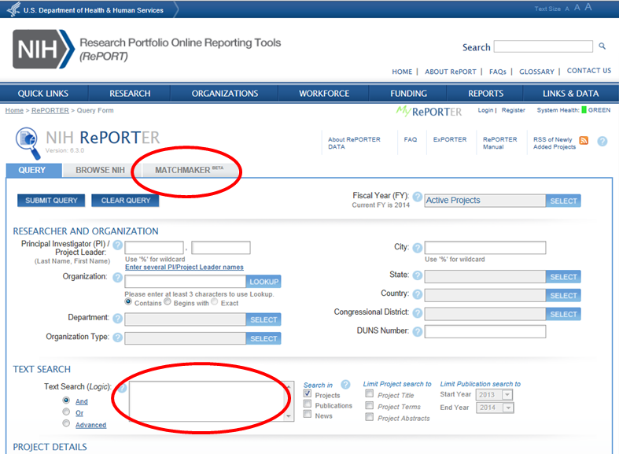
3. Help Direct Your Application to the Best Place for Review and Funding
http://projectreporter.nih.gov/reporter.cfm
Notes:
NIH Matchmaker is a tool to find similar NIH projects. It can help you to find which institutes and Centers have funded similar work, and where the work was reviewed.

Slide 25
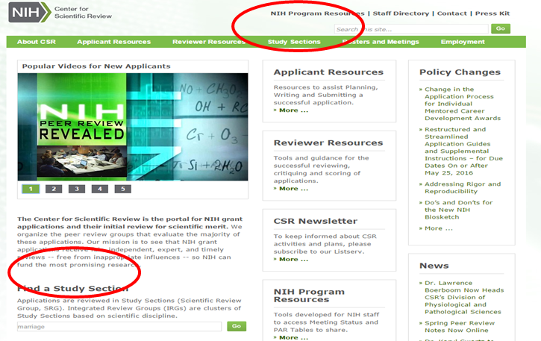
3. Help Direct Your Application to the Best Place for Review and Funding
http://www.csr.nih.gov
Notes:
Applications are reviewed in Study Sections (Scientific Review Group, SRG). Integrated Review Groups (IRGs) are clusters of Study Sections based on scientific discipline. Applications generally are assigned first to an IRG, and then to a specific study section within that IRG for evaluation of scientific merit. You can request assignment of your application to a study section where you think is the best scientific expertise for your application.

Slide 26
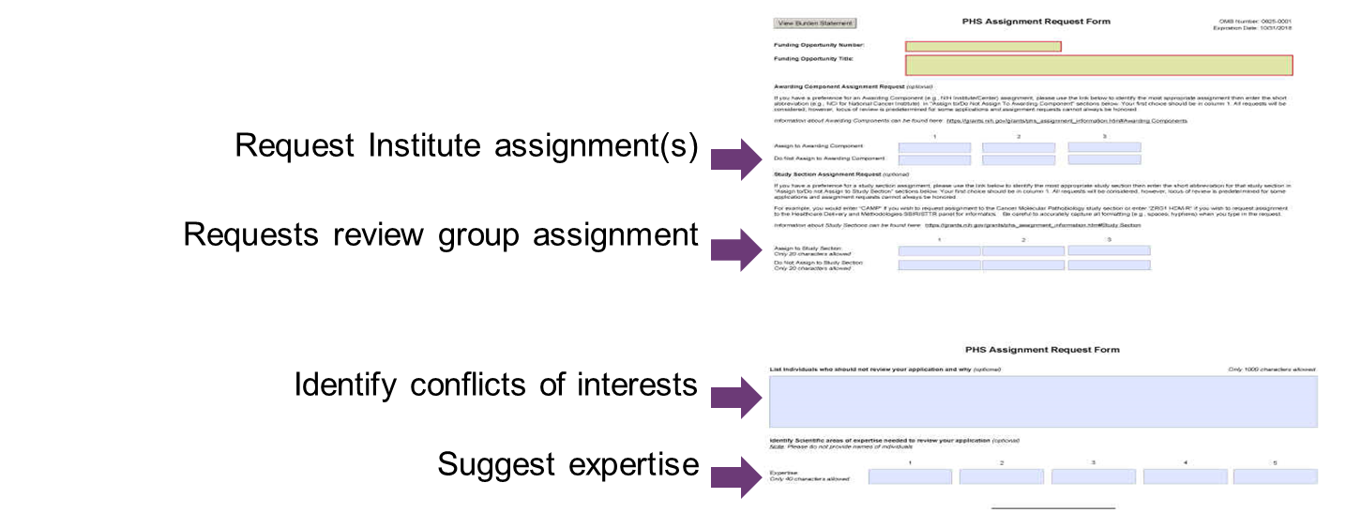
Assignment Request Form
Never Request Specific Reviewers
Notes:
Use the Assignment Request Form (optional form in application packets) to convey any assignment requests to the Division of Receipt and Referral, Center for Scientific Review. Do not use a cover letter for this information. See NOT-OD-16-008 for more information about how to use this form.

Slide 27
4. Understand Who Your Reviewers Are
Reviewers:
Have a broad range of scientific expertise and background
Are experts in the field, but maybe not in exact area of your application
Notes:
Can be one or multiple slides…..

Slide 28
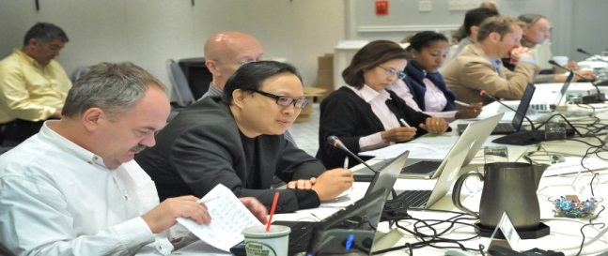
4. Understand Who Your Reviewers Are
Check Out Study Section Rosters
www.csr.nih.gov/rosters
Notes:
Of course, it never hurts to cite the research of a reviewer on your panel if it is very germane to your proposed research.

Slide 29
5. Know What Reviewers Are Looking for
Impact
Exciting ideas
Clarity
Realistic aims and timelines -- Don’t be overly ambitious
Brevity with things that everybody knows
Noted limitations of the study
A clean, well-written application

Slide 30
Review Criteria
5. Know What Reviewers Are Looking for
Overall Impact
Assessment of the likelihood for the project to exert a sustained, powerful influence on the research field(s) involved
Core Review Criteria
Significance
Investigator(s)
Innovation
Approach
Environment
Review criteria each scored from 1-9 (best-worst)
Additional Review Criteria
Commercial Potential (Phase I)
Commercialization Plan (Phase II)
Quantitative Milestones (Fast-Track)

Slide 31
Four Things to Know about Reviews for Rigor and Transparency For Research Project Grant Applications (including SBIR/STTR applications)
5. Know What Reviewers Are Looking for

Slide 32
Four Rigor and Transparency Review Elements Research Project Grant Applications
Can Affect Your Overall Impact Score!
Rigor and Transparency Element | What’s added to the review criteria? | Where in the application?
1. Scientific Premise | Is there a strong scientific foundation for the project? | Research Strategy (Significance)
2. Scientific Rigor | Are there strategies to ensure a robust and unbiased approach? | Research Strategy (Approach)
Notes:
Rigor and transparency do not apply to all applications. See List of Eligible Activity Codes: https://nih-extramural-intranet.od.nih.gov/d/sites/default/files/RigorActivityCodes-20151006.pdf. Also, certain Funding Opportunity Announcements are exempt from rigor, by request from the ICs.

Slide 33
Four Rigor and Transparency Review Elements Projects with Vertebrate Animals and/or Human Subjects
Can Affect Your Overall Impact Score!
Rigor and Transparency Element | Where in the application? | What’s added to the review criteria?
3. Consideration of Relevant Biological Variables, Such as Sex | Research Strategy (Approach) | Are adequate plans to address relevant biological variables, such as sex, included for studies in vertebrate animals or human subjects?

Slide 34
Four Rigor and Transparency Review Elements Projects Involving Key Biological and/or Chemical Resources
Rigor and Transparency Element | Which applications? | Where in the application? | What’s added to the review criteria?
4. Authentication of Key Biological and/or Chemical Resources | Project involving key biological and/or chemical resources | New Attachment | Comment on plans for identifying and ensuring validity of resources.
Won’t Affect Your Overall Impact Score

Slide 35
6. Consider Advice from NIH Reviewers and Staff

Slide 36
6. Consider Advice from NIH Reviewers and Staff
Articulate each aim and how it advances the overall project

Slide 37
6. Consider Advice from NIH Reviewers and Staff
Articulate each aim and how it advances the overall project
Tell reviewers:
What you will do

Slide 38
6. Consider Advice from NIH Reviewers and Staff
Articulate each aim and how it advances the overall project
Tell reviewers:
What you will do
Why it is important

Slide 39
6. Consider Advice from NIH Reviewers and Staff
Articulate each aim and how it advances the overall project
Tell reviewers:
What you will do
Why it is important
How you will do it

Slide 40
6. Consider Advice from NIH Reviewers and Staff
Articulate each aim and how it advances the overall project
Tell reviewers:
What you will do
Why it is important
How you will do it
How each piece contributes to the whole

Slide 41
6. Consider Advice from NIH Reviewers and Staff
Articulate each aim and how it advances the overall project
Tell reviewers:
What you will do
Why it is important
How you will do it
How each piece contributes to the whole
What is the commercial potential, commercialization plan, commercial feasibility

Slide 42
6. Consider Advice from NIH Reviewers & Staff
Start with significance

Slide 43
6. Consider Advice from NIH Reviewers & Staff
Start with significance
Current controversies or issues of importance to the field

Slide 44
6. Consider Advice from NIH Reviewers & Staff
Start with significance
Current controversies or issues of importance to the field
Bring something new to the table

Slide 45
6. Consider Advice from NIH Reviewers & Staff
Start with significance
Current controversies or issues of importance to the field
Bring something new to the table
Broad enough to be of interest to general field

Slide 46
6. Consider Advice from NIH Reviewers & Staff
Start with significance
Current controversies or issues of importance to the field
Bring something new to the table
Broad enough to be of interest to general field
Keep it focused and feasible

Slide 47
6. Consider Advice from NIH Reviewers & Staff
Start with significance
Current controversies or issues of importance to the field
Bring something new to the table
Broad enough to be of interest to general field
Keep it focused and feasible
Be self-critical and propose alternatives

Slide 48
6. Consider Advice from NIH Reviewers & Staff
Start with significance
Current controversies or issues of importance to the field
Bring something new to the table
Broad enough to be of interest to general field
Keep it focused and feasible
Be self-critical and propose alternatives
Insert summaries to reinforce key points

Slide 49
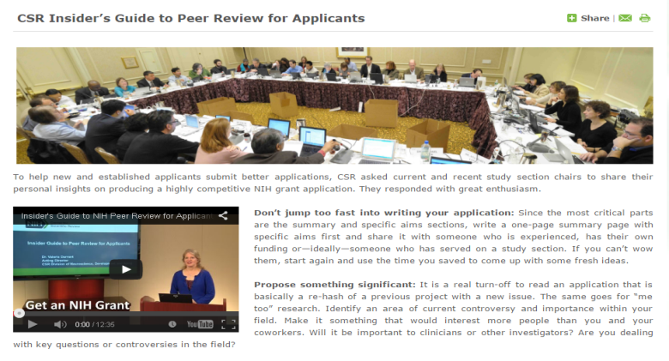
6. Consider Advice from NIH Reviewers and Staff
Check Out the Insider’s Guide to NIH Peer Review for Applicants
http://www.csr.nih.gov/applicantResources/Insider

Slide 50
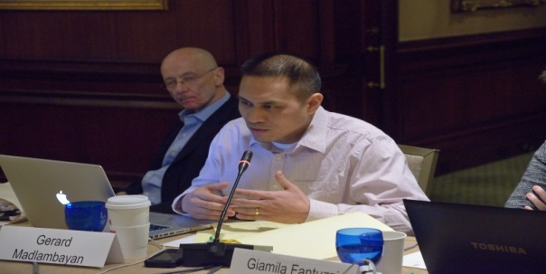
7. Benefit from Becoming Review Panel Member
Become an Early Career Reviewer
Increase Your Chances of Getting Your SBIR/STTR Grant
Notes:
Our Early Career Reviewer Program can give you insights that have been shown to increase a new applicant’s grant success rate.
ECR reviewers -- attend a study section meeting
Serve as the 3rd assigned reviewer for 2-4 applications (Didn’t explain 1-2-3- reviewer roles in Webinar)
Write full critiques for these applications
Participate in the full review meeting

Slide 51
Qualifications for the Early Career Reviewer Program
Demonstrated training and experience in the scientific areas under review as evidenced by:
Two or more years in faculty appointment or the equivalent
An active independent program of research or product development
At least 2 senior authored research publications in peer reviewed journals in the past 2 years or equivalent accomplishments working in a non-academic setting
You cannot have an R01 grant or have served on a CSR study section.

Slide 52
How Can I Become an Early Career Reviewer?
Apply! Instructions at www.csr.nih.gov/ECR
If you are accepted, we will:
Place your name in our ECR database
Invite you to serve if your expertise is needed to review particular applications

Slide 53
8. Ask the Right NIH Person for Help
Before You Submit Your Application
A Program Officer at an NIH Institute or Center
Scientific Review Officer
After You Submit
Your Scientific Review Officer
After Your Review
Your Assigned Program Officer
GrantsInfo: GrantsInfo@nih.gov – 301 435-0714
Notes:
Note program officers can give applicants insight into the relevance of an application to their IC’s goals and their possible level of interest in it.
GrantsInfo staff can answer basic questions about the NIH grants and peer review system.

Slide 54
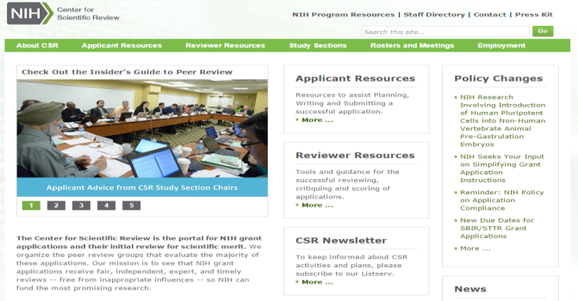
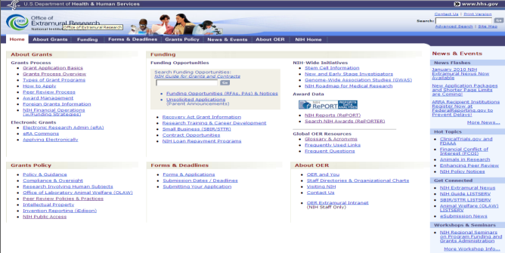
Key NIH Review and Grants Web Sites
NIH Center for Scientific Review
http://www.csr.nih.gov
NIH Office of Extramural Research
http://grants.nih.gov/
Notes:
A lot of critical information and answers to your questions can be found online . . . .

Slide 55
Overview of HHS SBIR/STTR Programs
Matthew Portnoy, Ph.D.
SBIR/STTR Program Coordinator
Director of the Division of Special Programs
Office of Extramural Research, NIH

Slide 56
NIH SBIR/STTR Website
https://sbir.nih.gov

Slide 57
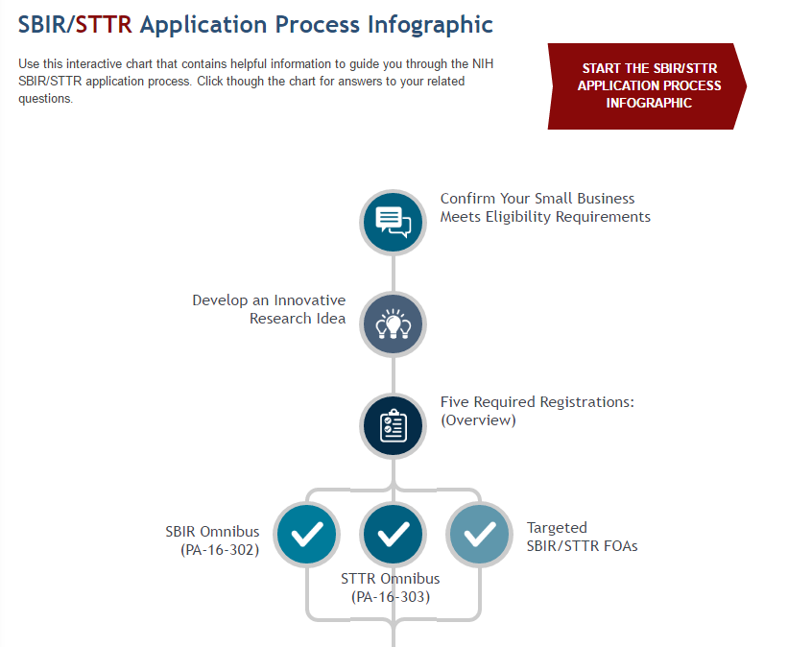
New to SBIR/STTR?
http://sbir.nih.gov/infographic

Slide 58
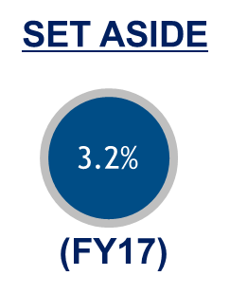
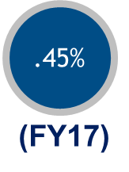
Congressionally Mandated Programs
SMALL BUSINESS INNOVATION
RESEARCH (SBIR) PROGRAM
Set-aside program for small business concerns to engage in federal R&D -- with potential for commercialization
SMALL BUSINESS TECHNOLOGY
TRANSFER (STTR) PROGRAM
Set-aside program to facilitate cooperative R&D between small business concerns and US
research institutions -- with potential for commercialization

Slide 59
SBIR Purpose and Goals
Stimulate technological innovation
Use small business to meet federal R&D needs
Foster and encourage participation by minorities and disadvantaged persons in technological innovation
Increase private-sector commercialization innovations derived from federal R&D
Small Business Innovation Development Act of 1982
P.L. 114-328 Re-Authorizes program through FY2022

Slide 60
STTR Purpose and Goals
Stimulate and foster scientific and technological innovation through cooperative research and development carried out between small business concerns and research institutions
Foster technology transfer between small business concerns and research institutions
Small Business Research and Development
Enhancement Act of 1992
P.L. 114-328 Re-Authorizes program through FY2022

Slide 61
SBIR/STTR Reauthorization update
Congress passed a 5 year SBIR/STTR Reauthorization as part of S.2943, the 2017 National Defense Authorization Act (NDAA)
SBIR/STTR programs reauthorized for 5 year FY18 through FY22
Simple, one line reauthorization
No pilot programs extended, all expire 9/30/17
Direct Phase II
CRP
3% Agency SBIR Admin funds
NIH Phase 0 Proof of Concept Centers
Bills circulating in Congress as we speak on these and other areas. – Stay tuned.

Slide 62
SBIR/STTR Budgets by Agency FY15
Agencies with SBIR and STTR Programs | Budget
Department of Defense (DOD) | $1.070B
Department of Health and Human Services (HHS), including the National Institutes of Health (NIH)* | $797.0M
Department of Energy (DOE), including Advanced Research Projects Agency – Energy (ARPA-E) | $206.1M
National Aeronautics and Space Administration (NASA) | $180.1M
National Science Foundation (NSF) | $176.0M
Agencies with SBIR Programs | Budget
U.S. Department of Agriculture (USDA) | $25.3M
Department of Homeland Security (DHS): Science and Technology Directorate (S&T) and Domestic Nuclear Detection Office (DNDO) | $17.7M
Department of Commerce: National Oceanic and Atmospheric Administration (NOAA) and National Institute of Standards and Technology (NIST)* | $8.4M
Department of Transportation (DOT) | $7.9M
Department of Education (ED) | $7.5M
Environmental Protection Agency (EPA) | $4.2M

Slide 63
HHS Program Funding
2017 Budget | SBIR | STTR
NIH | $861M | $121M
CDC | ~$11.0M | N/A
ACL (NIDILRR) | ~$3M | N/A
FDA | ~$1.4M | N/A

Slide 64
Program Eligibility Criteria
Organized as for-profit US business
Small: 500 or fewer employees, including affiliates
Work must be done in the US (with few exceptions)
Individual Ownership:
Greater than 50% US-owned by individuals and independently operated OR
Greater than 50% owned and controlled by other business concern/s that is/are greater than 50% owned and controlled by one or more individuals OR
Be a concern which is more than 50% owned by multiple venture capital operating companies, hedge funds, private equity firms, or any combination of these (For FOAs after 1/28/2013 NIH; 7/10/14 CDC)
Determined at Time of Award

Slide 65
STTR Eligibility Criteria
Applicant is a Small Business Concern
Formal Cooperative R&D Effort
Minimum 40% by small business
Minimum 30% by US research institution
US Research Institution
College or university; other non-profit research organization; Federal R&D center
Intellectual Property Agreement
Allocation of rights in IP and rights to carry out follow-on R&D and commercialization

Slide 66
NIH SBIR/STTR 3-Phase Program
Phase I Feasibility Study
Budget Guide: $150K for SBIR and STTR
Project Period: 6 months (SBIR); 1 year (STTR)
Phase II Full Research/R&D
$1M for SBIR and STTR, over two years
Phase IIB Competing Renewal/R&D
Clinical R&D; Complex Instrumentation/to FDA
Many, but not all, IC’s participate
Varies~$1M per year; up to 3 years
Phase
IIB
Phase III Commercialization
NIH, generally, not the “customer”
Consider partnering and exit strategy early

Slide 67
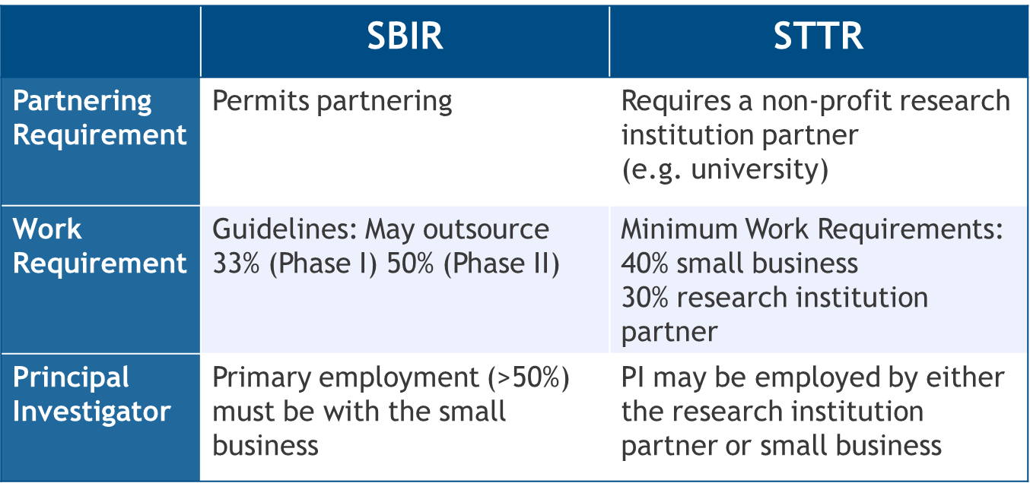
SBIR and STTR Critical Differences
Award is always made to the small business

Slide 68
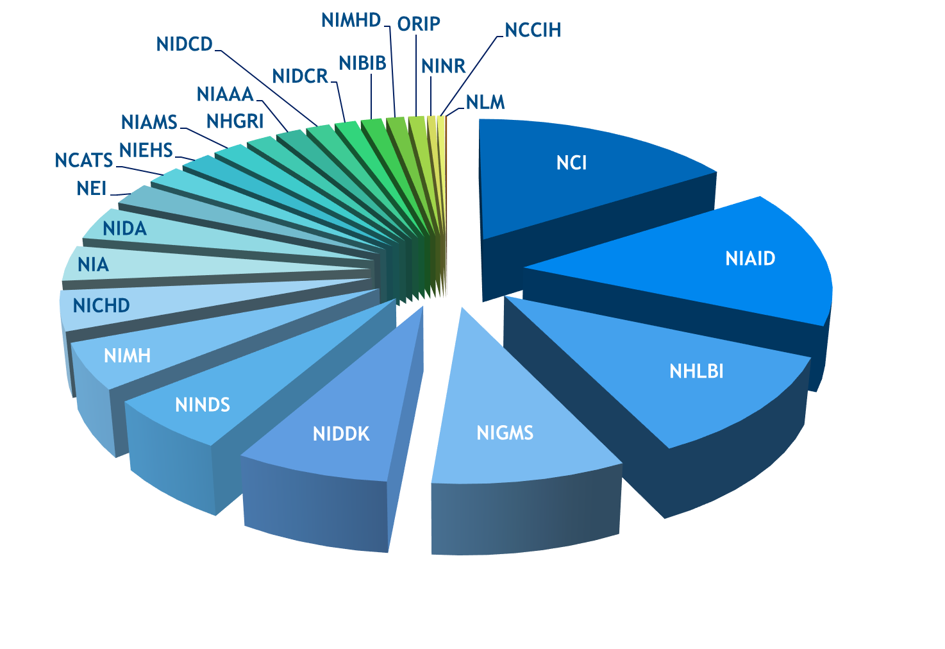
NIH SBIR/STTR Budget Allocations FY2017
3.2% SBIR $861.4M
0.45% STTR $121.1M
Total FY17 $982.5M

Slide 69
Solicitations and Due Dates
NIH, CDC, FDA, & ACF SBIR/STTR Grant Solicitation “Parent” FOAs: SBIR: PA-17-302 STTR: PA-17-303
Release: June 5, 2017
Standard Due Dates: September 5th, January 5th
These FOAs are being issued with limited due dates to accommodate the transition from FORMS-D to FORMS-E application packages.
HHS expects to re-issue these Omnibus after the January 5, 2018 due date.
SBIR Contract Solicitation (NIH, CDC) – Program Solicitation PHS 2018-1 (SBIR Only)
NIH Guide Notice NOT-OD-17-098
Release: 7/18/17 Due: 10/20/17
NIH Guide for Grants and Contracts
Weekly receipt dates specified in each FOA

Slide 70
Most Important Piece of Advice
Talk to a HHS Program Officer at least a month before a deadline for application specific advice.
Click here for the list of HHS SBIR Program Managers
Not sure who to contact? Email sbir@od.nih.gov

Slide 71
More Information
Get Connected!
Subscribe to the SBIR/STTR Listserv:
Email LISTSERV@LIST.NIH.GOV with the following text in the message body: subscribe SBIR-STTR your name
NIH Guide for Grants and Contracts (weekly notification)
Follow us on Twitter: @NIHsbir
Read our NIH SBIR/STTR Success Stories
Connect with Us
Email: sbir@od.nih.gov

Slide 72
Preparing for 2017-2018!
SAVE THE DATE!
November 7-9, 2017
Milwaukee, Wisconsin
https://ctsi.mcw.edu/event/nih-sbir-milwaukee-2017/

Slide 73
For More Information
Matthew Portnoy, PhD
NIH SBIR/STTR Program Coordinator
Phone: 301-435-2688
Email: mportnoy@mail.nih.gov
Robert Vinson
SBIR/STTR Program Manager
Phone: 301-435-2713
Email: vinsonr@mail.nih.gov
JP Kim, JD, MBA, MSc
SBIR/STTR Program Manager
Phone: 301-435-0189
Email: jpkim@nih.gov
Julie Beaver, MD, MS
SBIR/STTR Statistician
Phone: 301-496-8807
Email: julie.beaver@nih.gov
Patricia Swayne
SBIR/STTR Communications
Specialist
Phone: 301-402-1632
Email: patricia.swayne@nih.gov

