Slide 1
How Your Application Is Reviewed
Robert Elliott, Ph.D.
Scientific Review Officer (SRO)

Slide 2
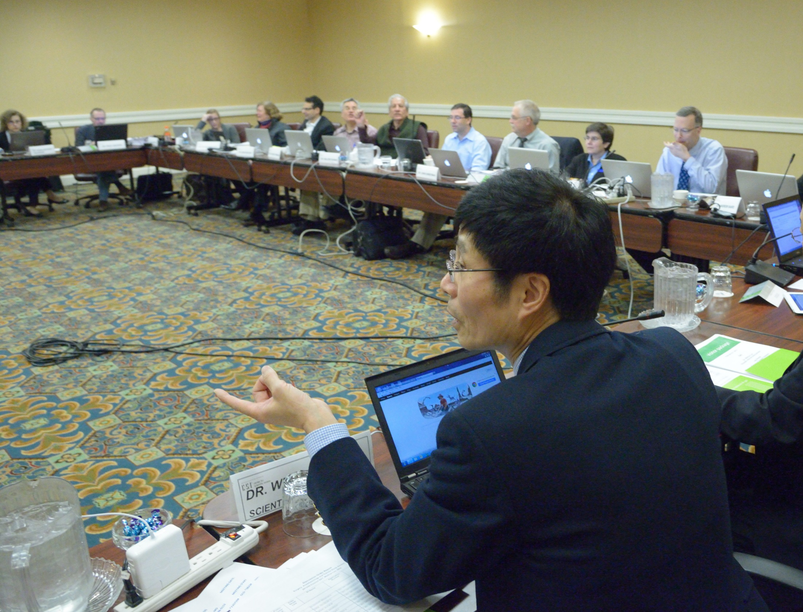
Your Scientific Review Officer Takes Charge
Your SRO is a doctoral-level scientist with expertise relevant to
your field who manages the overall peer review of your application.
Notes:
The overall peer review process of your application is managed by a designated federal official, the scientific review officer or SRO, who has doctoral level expertise relevant to your field.

Slide 3
Your SRO Assigns at Least Three Reviewers to Your Application
Notes:
In preparation for a study section meeting, at least three scientists with broad experience in the external scientific community are assigned to your application by the SRO. Extra reviewers may be recruited to ensure your application is reviewed appropriately.
Reviewers receive applications and their specific assignments 6 – 8 weeks in advance of the scheduled date of the meeting allowing them plenty of time to prepare. It is typical for each member of a panel to have 8 – 10 total application assignments.
Reviewers assess each application by providing prior to the meeting:
A preliminary Overall Impact score
Criterion Scores for each of the 5 Core Review Criteria
A written critique

Slide 4
What Your SRO Looks for When Recruiting Reviewers
Demonstrated scientific expertise/research support
Doctoral degree or equivalent
Mature judgment
Work effectively in a group context
Breadth of perspective
Impartiality
Diversity
Geographic distribution

Slide 5
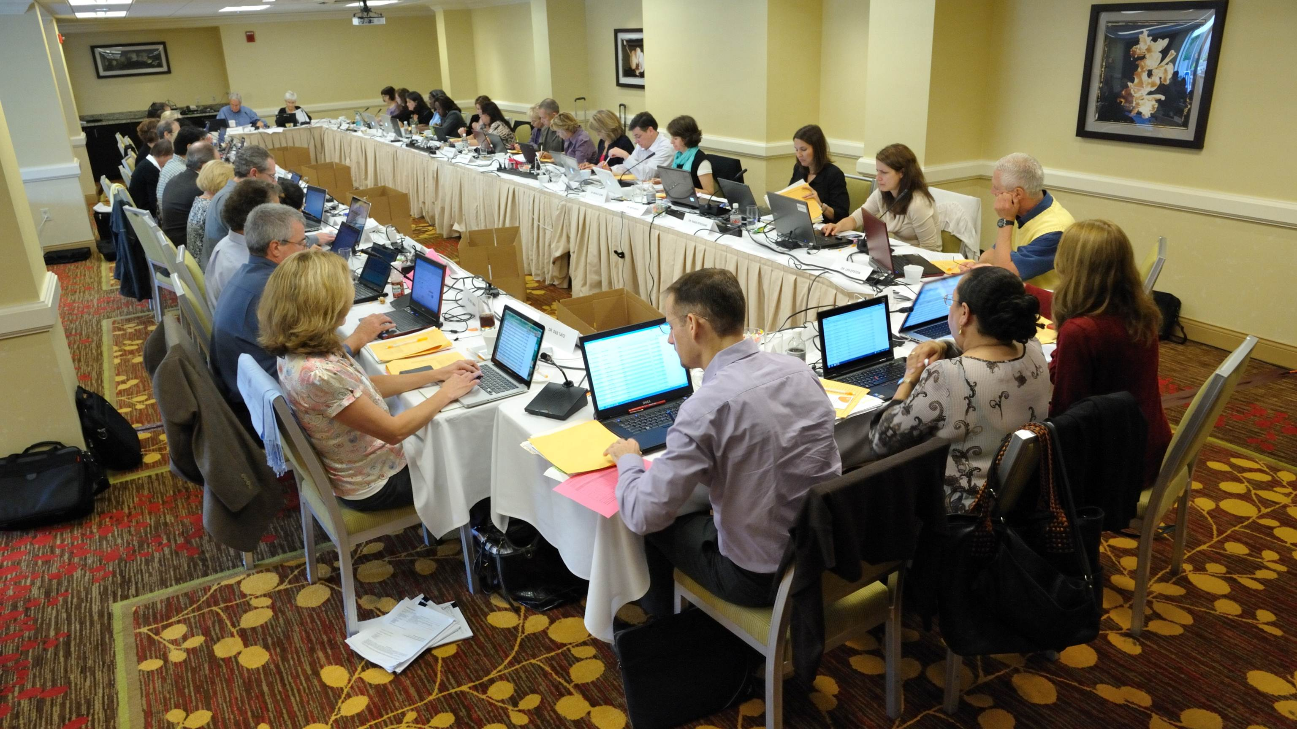
The Study Section Meeting
Your SRO Convenes the Study Section Meeting
Notes:
WHAT IS A STUDY SECTION MEETING LIKE?
Each CSR standing Study Section has typically ~12-25 regular members who are primarily from academia, but also from biotech industry and sometimes government research laboratories. Temporary members may be recruited to fulfill specific review needs.
Typically about 60-100 applications are reviewed by each study section

Slide 6
At the Meeting: Application Discussion
Any member in conflict with an application leaves the room
Reviewer 1 introduces the application and presents critique
Reviewers 2 and 3 highlight new issues and areas that significantly impact scores
All eligible members are invited to join the discussion and then vote on the final overall impact score

Slide 7
Discussions Focus on the Best Applications
Reviewers typically discuss the top half of the applications
The panel will discuss any application a reviewer wants to discuss
Notes:
The remaining applications will not be discussed unless explicitly recalled by any member of the panel. Even if your application is not discussed, you will receive the detailed critiques from each of your assigned reviewers.
We've talked broadly about evaluation and alluded to scoring. Let's look at more detail of how this is done.

Slide 8
Career Stage Consideration
New Investigator or Early Stage Investigator Applications
R01 grant applications: Your status is formally considered and NIH is committed to funding a significant number of these applications.
Other grant applications: Your career stage is factored into the Investigator critique.
NIH must have correct info on your career stage
Notes:
A new investigator in NIH context is an applicant who has not yet successfully competed for a substantial NIH research grant.
Early Stage Investigators are New Investigators who are within 10 years of completing their terminal research degree or their medical residency at the time they apply for R01 grants.

Slide 9
Main Review Criteria
Overall Impact
Assessment of the likelihood for the project to exert a sustained, powerful influence on the research field(s) involved
Core Review Criteria
Notes:
The Overall Impact score is the ultimate score in evaluation for DISCUSSED applications.
To arrive at an overall impact judgment, reviewers evaluate each application first according to a set of five specific core criteria as follows:

Slide 10
Core Review Criteria
Significance
Investigator(s)
Innovation
Approach
Environment

Slide 11
Additional Criteria Contribute to Overall Impact Scores
Protections for human subjects
Inclusions of women, minorities and children
Appropriate use of vertebrate animals
Management of biohazards
Notes:
These are factored into the Overall impact as appropriate.

Slide 12
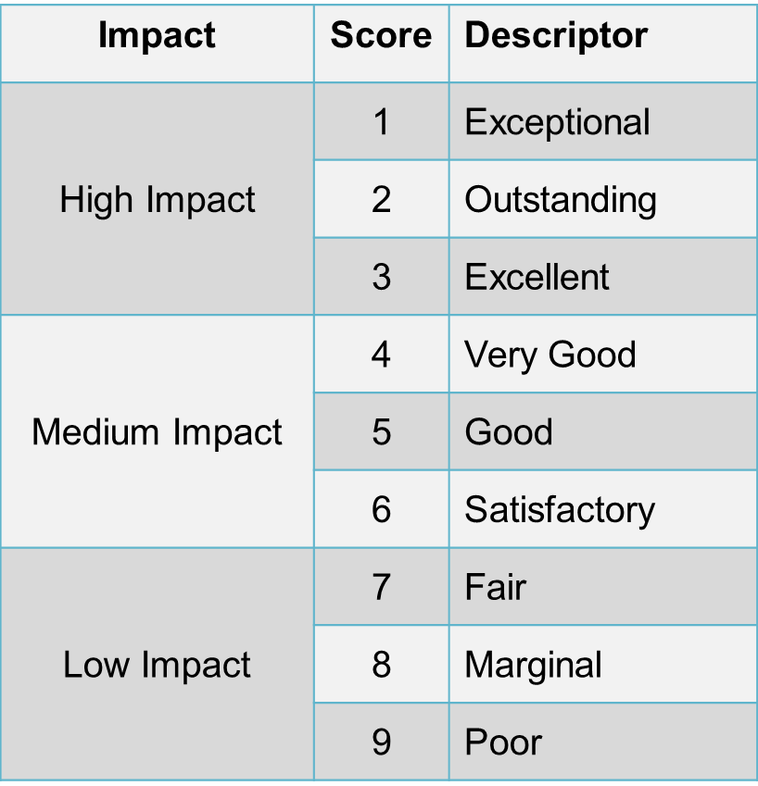
9-Point Scoring Scale
Notes:
Reviewers are asked to provide a numerical score for each of the five criterion areas and for overall impact. The NIH scoring system uses a 1 to 9 integer scale to score overall impact and these five criteria areas.
12

Slide 13
Scoring
Each panel member provides an overall impact score.
Range of Scores
After discussion, assigned reviewers state final Overall Impact Scores, defining the score range.
Panel members may vote outside this range although any intent to do so must be declared.
Notes:
If your application is among the ones discussed, then each member of the study section will provide a private overall impact score for your application assuming they have no conflict of interest.
If a reviewer votes outside the scoring range of the assigned reviewers, it is fine. Consensus is not the objective of a review. A reviewer may vote outside the range based on:
▪ a scientific difference of opinion
▪ different weighting of the review criteria
▪ a perceived mismatch between the words/score provided by the assigned reviewers
The reviewer’s dissent should be transparent from his/her participating in the discussion or raising a hand and providing a brief reason why at the time of final scoring.
The final overall impact priority scores for each application are averaged to 1 decimal place and multiplied by 10, ranging from10, most meritorious, to 90 least meritorious.
The budget is considered after scoring. The review group will either recommend the budget is funded as requested or suggest changes.

Slide 14
Other Considerations that Do Not Affect Overall Impact Scores
Resource Sharing Plans:
Data
Model Organisms
Genome Wide Association Studies
Foreign Organizations
Select Agents
Budget
Notes:
Data sharing plans are only needed for applications seeking $500,000 or more.
Select agents are a specific set of agents and toxins kept by CDC in a publically available list.

Slide 15
Your Application Could Be Reviewed Electronically
Electronic reviews are used to facilitate reviewer participation
Electronic Review Platforms
Telephone Assisted Meetings
Internet Assisted Meetings
Video Assisted Meetings

Slide 16
View the Video
http://www.csr.nih.gov/video/video.asp
Notes:
To give you an inside look at a peer review meeting, let’s look at a clip from our NIH Peer Review Revealed video. To save time, we won’t show you the first part of the review, where the first reviewer summarizes the application and discusses all the positive points. We’re going to jump to the part where reviewers worked out their differences.

Slide 17
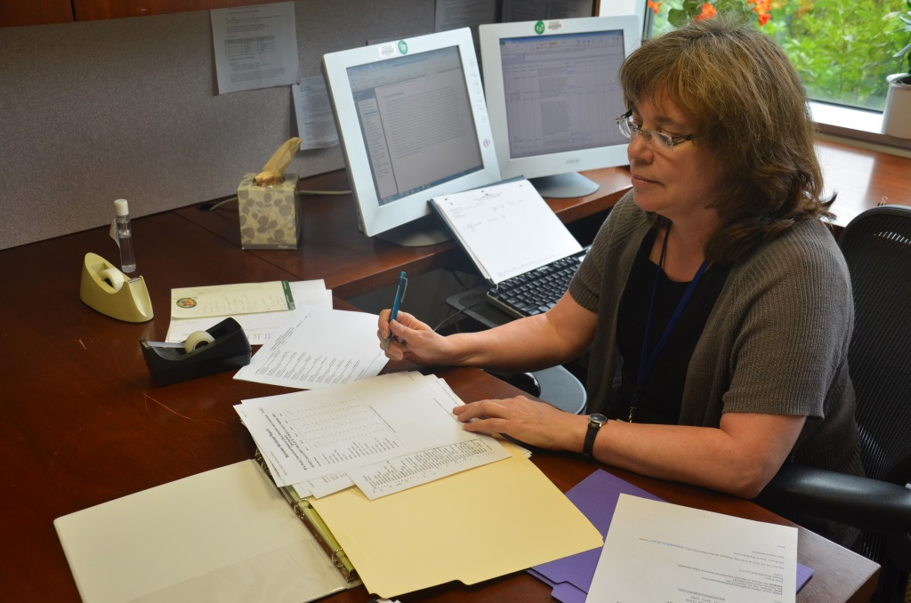
After Your Review
Your SRO
Prepares summary statements
Provides information to NIH Institutes and Centers
Notes:
responds to NIH institute and center requests for information about study section recommendations.

Slide 18
Your Summary Statement
Scores for each review criterion
Critiques from assigned reviewers
Administrative notes if any
If your application is discussed, you also will receive:
An overall impact/priority score and percentile
ranking
A summary of review discussion
Budget recommendations
Notes:
The summary (resume) of the discussion itself is written by the SRO
Summary statements are released within 30 days of the meeting except for R01 applications submitted by New Investigators or Early Stage Investigators, which are released within 10 business days of the meeting for first submissions only.
Once received, the Investigator/applicant may then discuss the contents of the summary statement with the Program Officer, but the SRO who prepared it is not at liberty to do so.

Slide 19
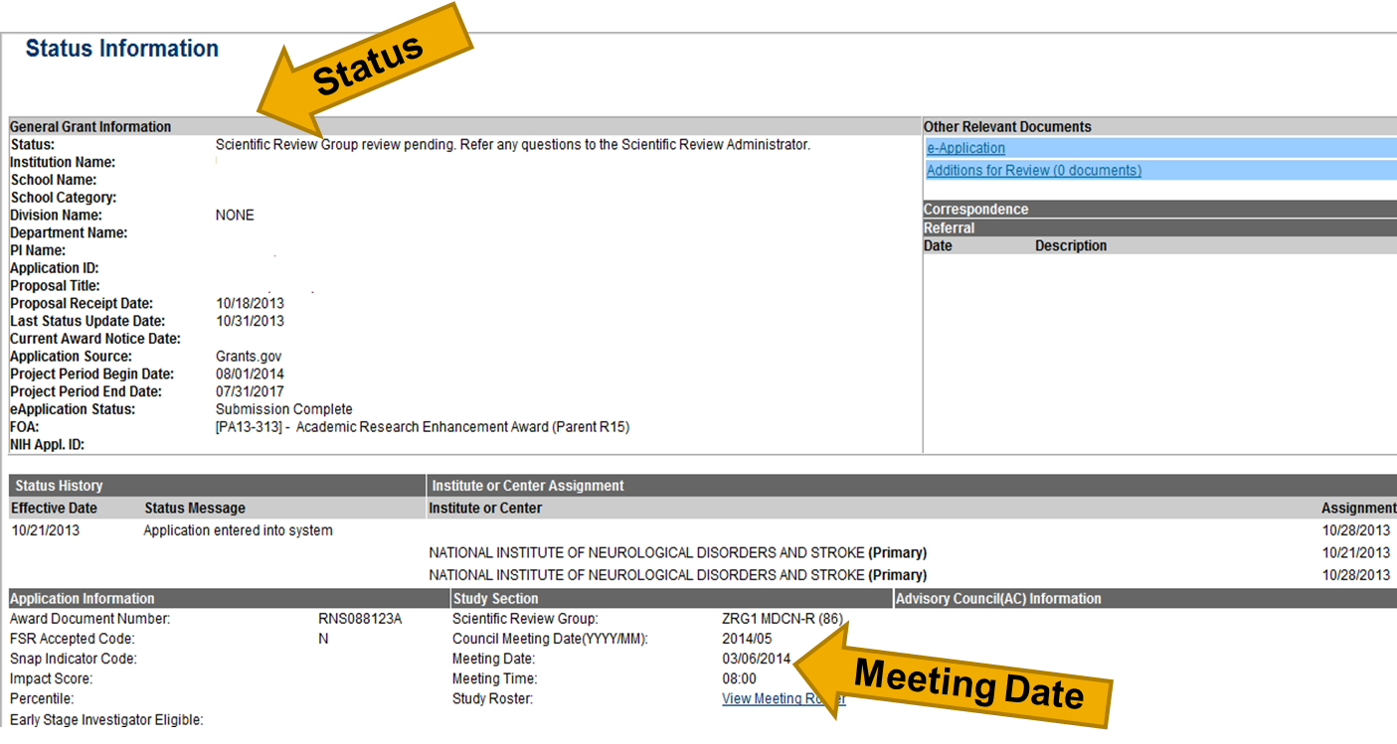
Check the Status of Your Application in NIH Commons
Notes:
The arrow at the top of the page points to the status of the sample application section, which states " Scientific Review Group review pending. Refer any questions to the Scientific Review Administrator." An arrow at the bottom of the image points to the date of the review meeting that will assess the given application.

Slide 20
When Preparing an Applications
Read instructions
Clearly state rationale and design of proposed investigation
Provide sufficient detail so reviewers will know what you mean
Refer to pertinent literature
Include well-designed tables and figures
Present an organized, lucid write-up
Obtain pre-review from faculty at your institution
NIH Grant Writing Tips
http://grants.nih.gov/grants/grant_tips.htm

Slide 21
What Reviewers Look for in Applications
Impact
Exciting ideas
Clarity
Realistic aims and timelines -- Don’t be overly ambitious
Brevity with things that everybody knows
Noted limitations of the study
A clean, well-written application
Notes:
Please proof read for typographical errors as this also makes a very favorable impression.
Balance with respect to detail: meaning brevity for things everybody knows across disciplines but give more/enough details so reviewers will know what you mean

Slide 22
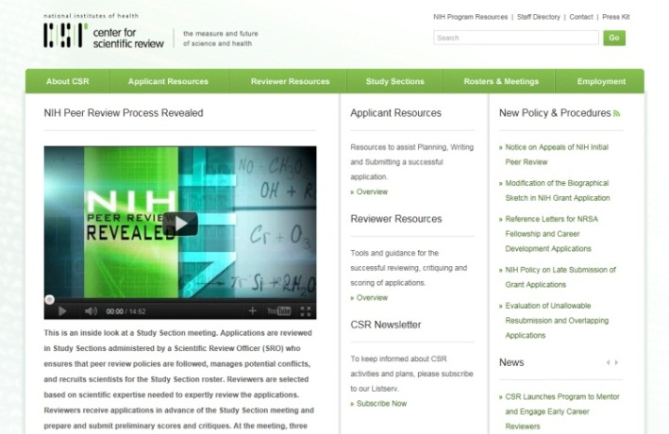
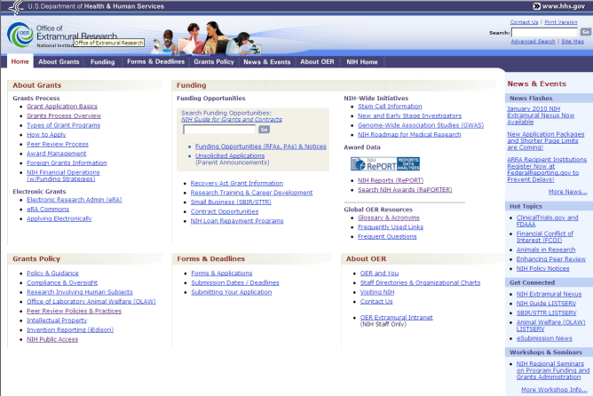
Key NIH Review and Grants Web Sites
NIH Center for Scientific Review
http://www.csr.nih.gov
NIH Office of Extramural Research
http://grants.nih.gov/
Notes:
A lot of critical information and answers to your questions can be found online . . . .

Slide 23
Who Can Answer Your Questions?
Before You Submit Your Application
A Program Officer at an NIH Institute or Center
Scientific Review Officer
After You Submit
Your Scientific Review Officer
After Your Review
Your Assigned Program Officer

