Slide 1
2023 CSR Incoming Chair Orientation Noni Byrnes, Ph.D. Director Center for Scientific Review

Slide 2
Agenda
11:00 – 11:20 am
Introductions, Overview of CSR and Peer Review Initiatives
11:20 – 11:35 am
Preparing to Chair – Dr. Bruce Reed
11:35 – 1:00 pm
Discussion – Facilitators Drs. Elia Ortenberg and Brian Scott
Bruce Reed, Ph.D.
Elia Ortenberg, Ph.D.
Brian Scott, Ph.D.
Deputy Director, Center for Scientific Review (CSR)
Chief, Social and Community Influences Across the Lifecourse Branch (SCIL)
Scientific Review Officer
Auditory System (AUD) Study Section

Slide 3
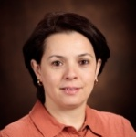
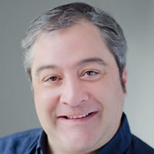
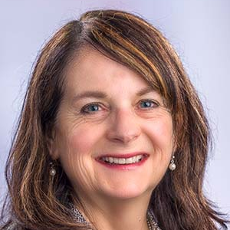
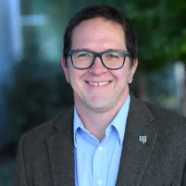
Thank You and Introductions
Dr. Sihem Boudina
Integrative Myocardial Physiology/Pathophysiology A (MPPA)
SRO: Dr. Abdelouahab Aitouche
Department of Nutrition and Integrative Physiology, University of Utah
Dr. Ralph Marcucio
Skeletal Biology Structure and Regeneration (SBSR)
SRO: Dr. Yanming Bi
Department of Orthopaedic Surgery, School of Medicine, University of California, San Francisco
Dr. Joseph Contessa
Drug Discovery and Molecular Pharmacology (DMPC)
SRO: Dr. Jeffrey Smiley
Department of Therapeutic Radiology, Yale University
Dr. Marian Neuhouser
Lifestyle and Health Behaviors (LHB)
SRO: Dr. Lisa Wigfall
Department of Cancer Prevention, Fred Hutchinson Cancer Center, University of Washington
Dr. Mark Frey
Digestive and Nutrient Physiology and Diseases (DNPD)
SRO: Dr. Aster Juan
Departments of Pediatrics, and Biochemistry and Molecular Medicine, University of Southern California
Dr. Joseph Sun
Cellular and Molecular Immunology B (CMIB)
SRO: Dr. Liying Guo
Immunology Program, Memorial Sloan Kettering Cancer Center
Dr. Scarlett Gomez
Cancer and Hematologic Disorders (CHD)
SRO: Dr. Steven Frenk
Department of Epidemiology and Biostatistics, University of California, San Francisco
Dr. Alexia Torke
Clinical Management in General Care Settings (CMGC)
SRO: Dr. Lauren Fordyce
Center for Aging Research, Indiana University
Dr. Shelley Hwang
Molecular Cancer Diagnosis and Classification (MCDC)
SRO: Dr. Lawrence Ng
Department of Surgery, Duke University
Dr. Terri Wood
Cellular and Molecular Biology of Glia (CMBG)
SRO: Dr. Sung-Wook Jang
Department of Pharmacology, Physiology, and Neuroscience, New Jersey Medical School, Rutgers University

Slide 4
The Critical Importance of Peer Review – The Main Driver of NIH Extramural Funding FY 2022 NIH Budget: $44.9 Billion
Intramural Research
Research Management & Support and Other
Spending at NIH
Spending at NIH
~80.9% Extramural Spending Outside NIH (~$36.8B)
~80.3% Extramural Spending Outside NIH (~$36B)
Supports over 300,000 Scientists & Research Personnel
Supports over 2,500 Institutions
CSR reviews >76% of all applications for NIH extramural funding (~ 61,000 per year)

Slide 5
CSR’s Mission
To ensure that NIH grant applications receive fair, independent, expert, and timely scientific reviews - free from inappropriate influences - so NIH can fund the most promising research.
Achieved through the invaluable contributions of over 19,000 volunteer reviewers every year, in over 1200 review meetings!

Slide 6
Fairness of the review process is fundamental to the mission
To ensure that NIH grant applications receive fair, independent, expert, and timely scientific reviews - free from inappropriate influences - so NIH can fund the most promising research.
Unfairness or bias in the peer review process – i.e. the influence of anything outside of the review criteria -- has a direct impact on the study section’s influence and its ability to identify the strongest, most meritorious science.

Slide 7
Integrity of the review process is fundamental to the mission
To ensure that NIH grant applications receive fair, independent, expert, and timely scientific reviews - free from inappropriate influences - so NIH can fund the most promising research.
Violating the integrity or confidentiality of the peer review process undermines and diminishes the work of the study section in identifying the strongest, most innovative science in the field.

Slide 8
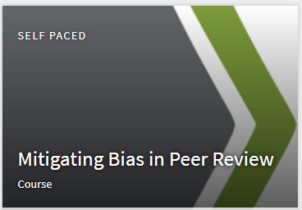
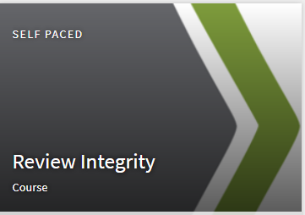
Chairs play a key role in the integrity and fairness of the review process
Reviewer training developed with input from scientific community through CSR Advisory Council
Chairs can actively promote these values, establish a culture of fairness and integrity in the study section – reinforce SRO’s messages, report integrity concerns, actively ensure participation, intervene early
A common theme within the post-training qualitative survey comments from reviewers: the need for chairs and SROs to intervene more…..“These two jobs have the most weight in the room”
More in today’s facilitated discussion

Slide 9
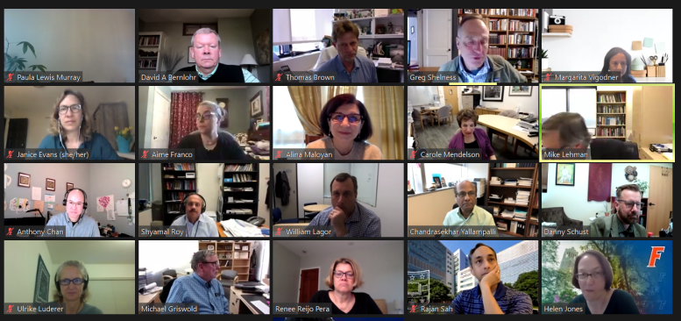
Updates: Study Section Meeting Format A careful, data-driven approach to decision-making
Since fall 2022, we’ve held 221 in-person meetings – one for each standing or recurring study section
Piloting hybrid meetings began with 13 study sections – refinement of logistics, technology, best practices for equitable engagement
CSR has conducted a comprehensive analysis of the in-person versus virtual fall 2022 meetings that includes both surveys to gauge reviewer experience/preference, and objective measures such as scoring data/outcomes, recruitment diversity, etc.
As expected, anecdotal response for in-person meetings has been very positive – exciting/energizing to meet in-person after the long dry spell of Zoom for three years. Sustained excitement, balanced with travel/time burden, remains a question.
Current plan is to continue one in-person meeting per year for each study section, expand hybrid options, continue to collect/analyze survey and objective data to drive future decisions

Slide 10
Updates: Preview of upcoming changes to peer review across NIH
CSR’s Bias Awareness and Review Integrity trainings will be required for all NIH reviewers in order to access their assigned applications in IAR – beginning in 2024; NOT-OD-23-156
Simplified review framework for NIH research project grants (RPGs) – 3-factor review framework based on recommendations by the CSR Advisory Council, largely positive public comments received – implementation plans under development – likely to be in place by early 2025. https://grants.nih.gov/policy/peer/Proposed-Framework/index.htm
Changes to NRSA fellowship review criteria and the application – based on recommendations by the CSR Advisory Council, currently being refined based on public feedback – likely to be in place by early 2025. https://grants.nih.gov/policy/peer/improving-nrsa-fellowship

Slide 11
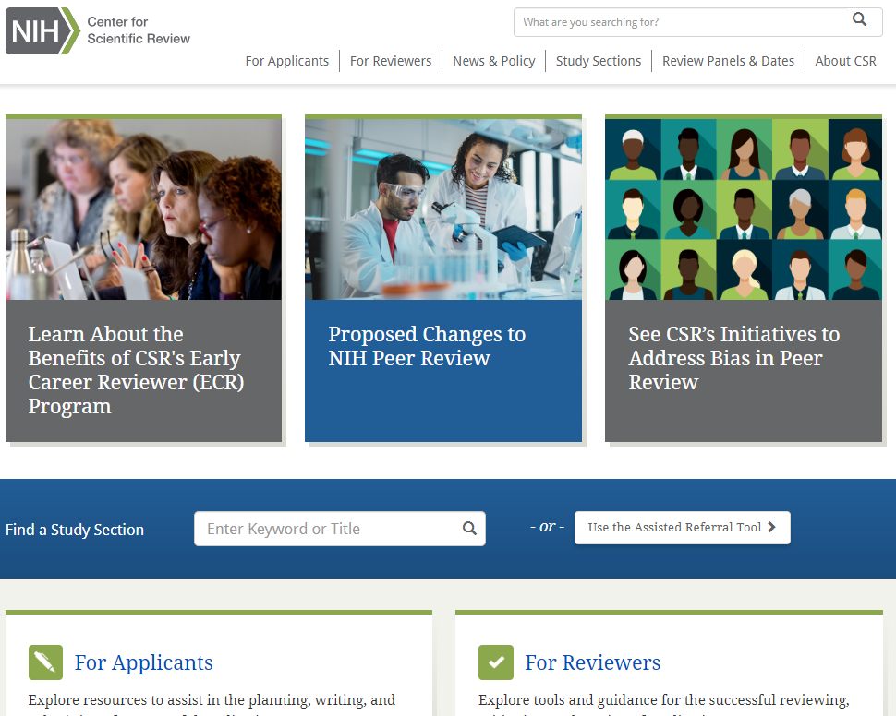
Learn more about other CSR initiatives and priorities
CSR’s Website: https://public.csr.nih.gov/
CSR’s 2022-2027 Strategic Plan
Data, full reports, analyses, e.g.
Upcoming changes in the review of RPGs, NRSA fellowships
Actions to address bias in peer review
Early Career Reviewer (ECR) program
In-person versus Zoom meeting evaluation
Reviewer demographics
CSR Advisory Council, Council working group reports
And much more…..
Q/A, Discussion, Comments noni.byrnes@nih.gov
Notes:
all kinds of cool stuff there (lots of data—make the point that we’re posting data), more on fighting bias, reports on SRF and RFR, Zoom data reports, data on CSR, on study section diversity.

